Slide 1
Interactive image segmentation by maximal similarity based region merging
2010 Pattern Recognition
報告組別：#16
組員：資工所 韓政廷
網媒所 林雨姍
資工四 沈子祺

Slide 2


purpose of this paper (1/2)
Extract something from pictures.

Slide 3
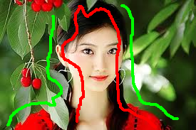
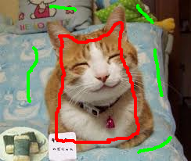
purpose of this paper (2/2)
How to extract ?
Draw lines pixel by pixel?
Use some interactive lines and the algorithm proposed in this paper.
Ridiculous!!!

Slide 4
Algorithm overview
1. Input initialization – cluster similar pixels
Mean shift
Watershed
2. Maximal-similarity based region merging (MSRM) – merge regions
Stage 1
Stage 2

Slide 5
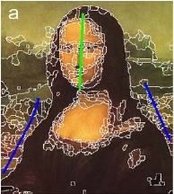
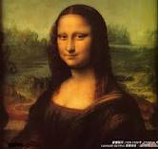
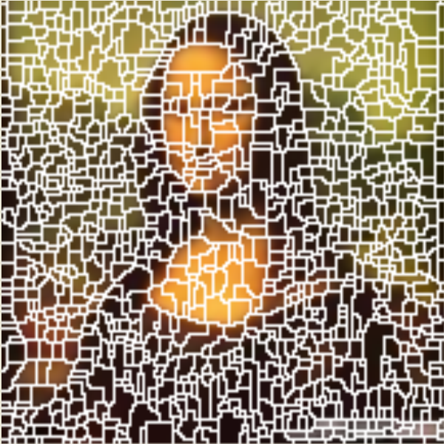
Input initialization
Mean shift
Hard to implement
Fewer region
Watershed
Easy to implement
More region

Slide 6
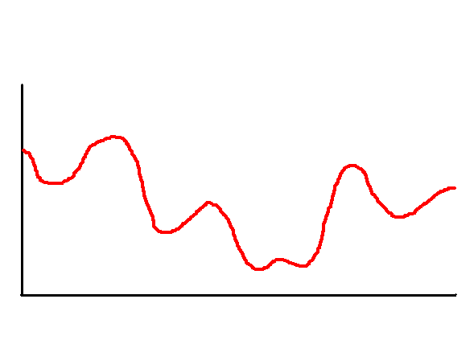
Input initialization – Watershed (1/3)
Local Minimum

Slide 7
Input initialization – Watershed (2/3)
Process
Smooth (Optional) – 2nd pdf of this class
Gradient – 3rd pdf of this class
Rain and construct dam

Slide 8

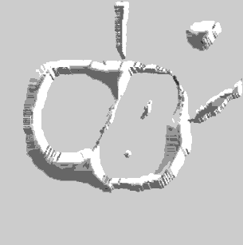
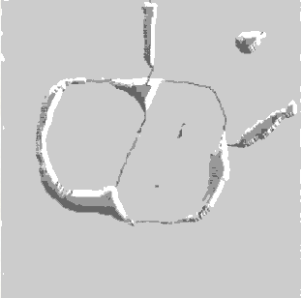
Input initialization – Watershed (3/3)

Slide 9
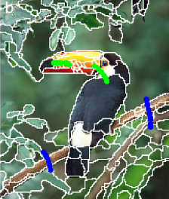
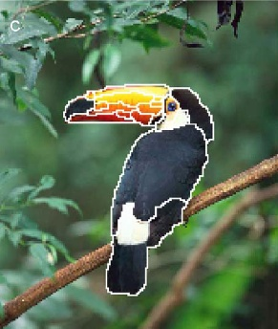
MSRM Algorithm
Stage 1 – Background marker regions MB
Stage 2 – Non-marker regions N

Slide 10
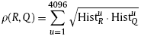
MSRM Algorithm – Stage 1 (1/2)
Feature – RGB color space histogram
Quantize into 16 levels for 3 channels
16 * 16 * 16 = 4096 dimensions
Normalized
ρ (R,Q) – Bhattacharyya coefficient
The angle/similarity between two feature vectors

Slide 11
MSRM Algorithm – Stage 1 (2/2)
For every background marker region P ∈ MB,
The set of P’s adjacent regions are Pi, i= 1, 2, … k .
For every adjacent regions of Pi, if ρ(P, Pi) is maximal, merge P and Pi.
Pi ∉ MB and Pi ∉ MO

Slide 12
MSRM Algorithm – Stage 2
For every non-marker region P ∈ N,
The set of P’s adjacent regions are Pi, i= 1, 2, … k .
For every adjacent regions of Pi, if ρ(P, Pi) is maximal, merge P and Pi.
Pi ∉ MB and Pi ∉ MO

Slide 13
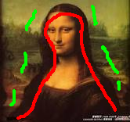
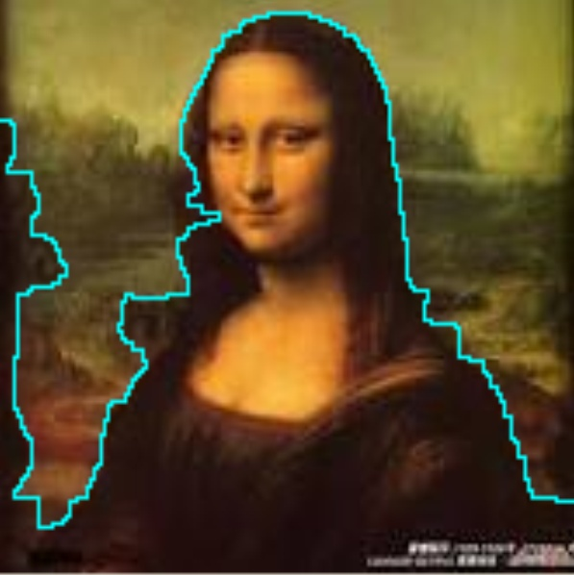
Algorithm overview

Slide 14
Experiment
Mona Lisa
Girl
Cat

Slide 15
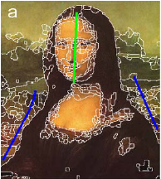
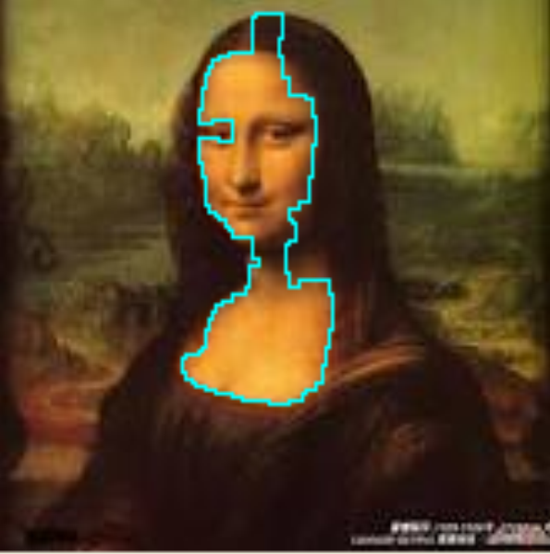
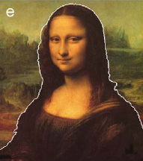
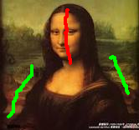
Experiment – Mona Lisa

Slide 16
Conclusion
Factors influence the result
The number of region
The interactive lines

Slide 17
reference
J. Ning, L. Zhang, D. Zhang, and C. Wu, “Interactive image segmentation by maximal similarity based region merging,” Pattern Recognition, vol. 43, no. 2, pp. 445-456, 2010.
D. Comaniciu and P. Meer, “Mean Shift: A robust approach toward feature space analysis,” IEEE Transactions on Pattern Analysis and Machine Intelligence, pp. 603-619, 2002
Rafael C. Gonzalez, Richard E. Woods, Digital Image Processing, 3rd Edition, pp. 769-778, Pearson Inc., 2008.

Slide 18
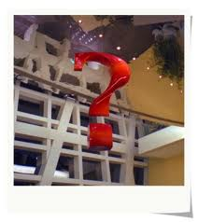
Any Question?

Slide 19


One Question - Complexity

Slide 20
Thanks for listening

